Slide 1

random Module

Slide 2
What is a Module?
Consider a module to be the same as a code library.
A file containing a set of functions you want to include in your application.

Slide 3
Built-in Functions
print()
input()
int()
float()
str()
bool()
list()
dict()
len()
max()
min()
sum()
range()
type()
round()
abs()

Slide 4
Types of Modules
Built-in Modules: These modules are part of Python's standard library and are included with the Python installation. random, datetime, os, etc.
User-defined Modules: These are modules that you create yourself to encapsulate specific functionalities within your own projects.
Third-Party Modules (External Packages): These are modules and packages written by external developers (the Python community) that are not included with the standard Python installation.

Slide 5
What is the random Module?
The random module is a built-in Python standard library module used to generate random numbers and make random selections. It should be imported using import random before its functions can be used.

Slide 6
Functions of the random module
random(), uniform(), triangular(), betavariate(), expovariate(), gammavariate(), gauss(), lognormvariate(), normalvariate(), vonmisesvariate(), paretovariate(), weibullvariate(), randint(), randrange(), getrandbits(), choice(), choices(), sample(), shuffle(), seed(), getstate(), setstate()

Slide 7
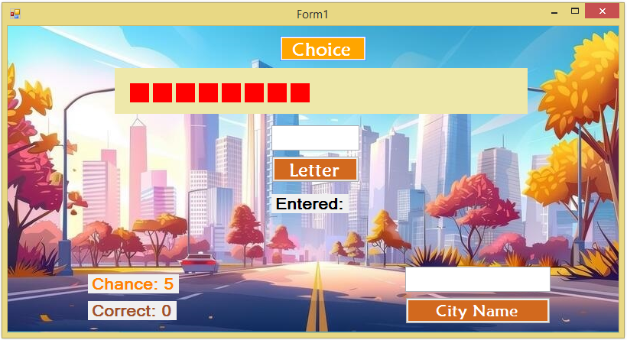
City Names Game

Slide 8
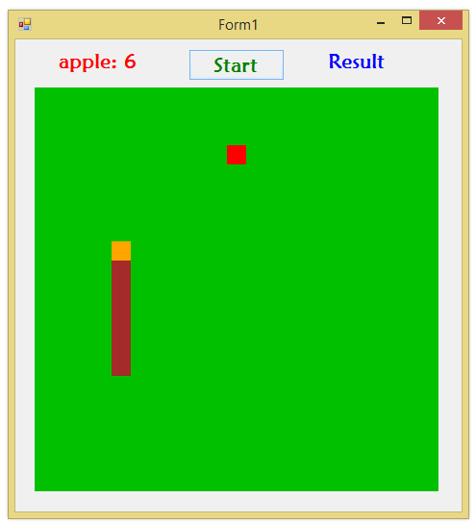
Snake Game

Slide 9
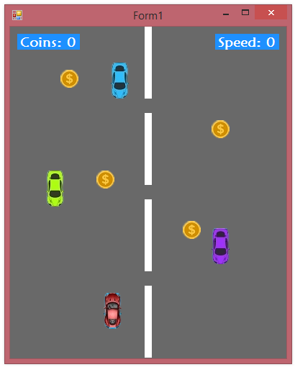
Car Racing Game

Slide 10
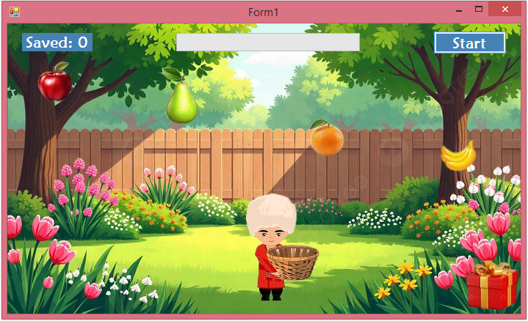
Collect Fruit Game

Slide 11
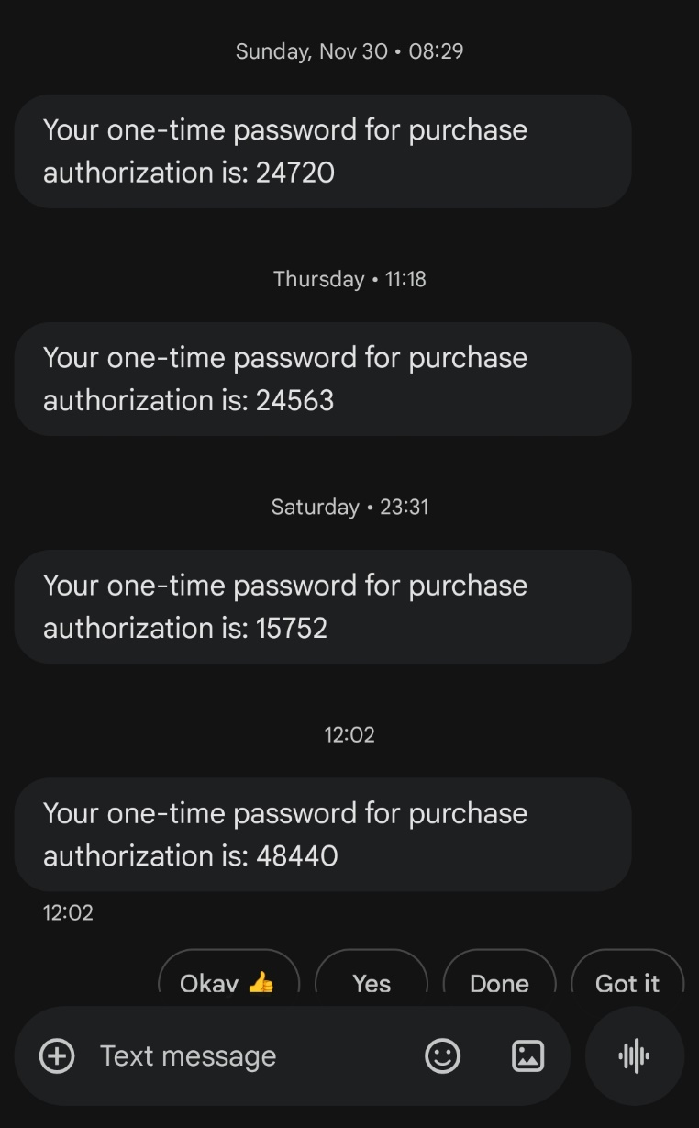
Phone Messages

Slide 12
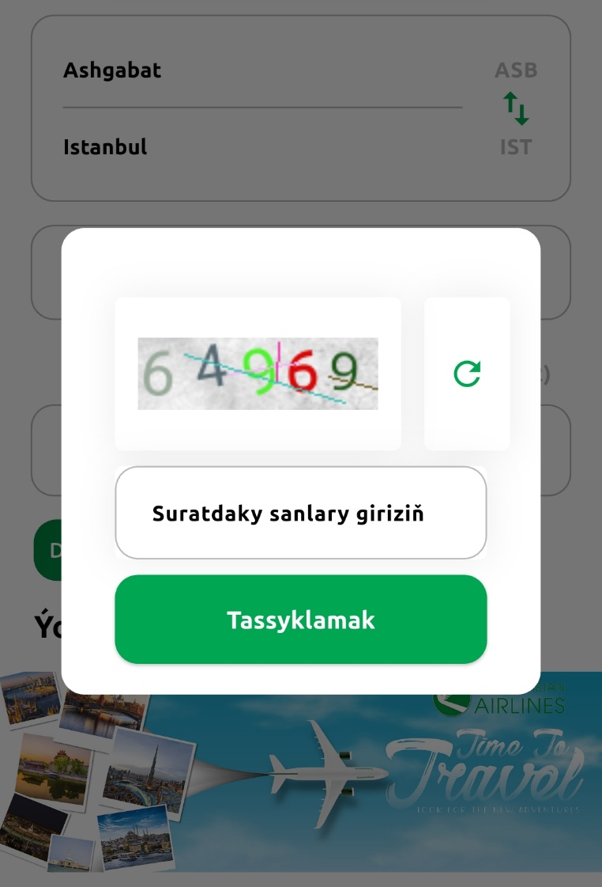
Turkmenistan Airlines App

Slide 13
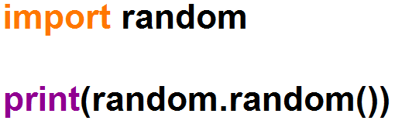

random() function
Returns a random float number between 0 and 1.

Slide 14
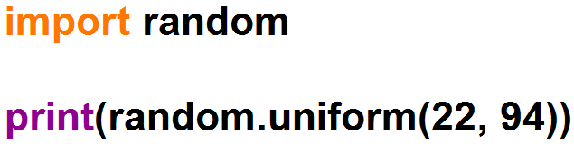

uniform() function
Returns a random float number between two given parameters.

Slide 15
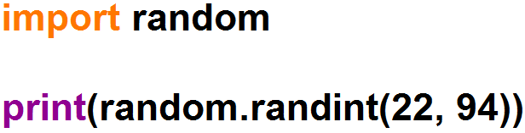

randint() function
Returns a random integer number between two given parameters.

Slide 16
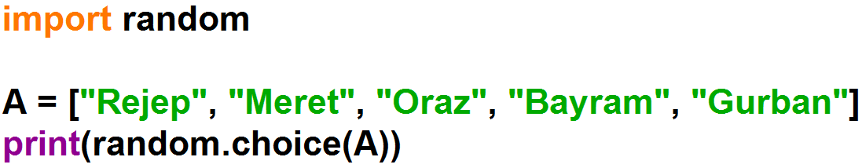

choice() function
Select a single, random element from a non-empty sequence.

Slide 17
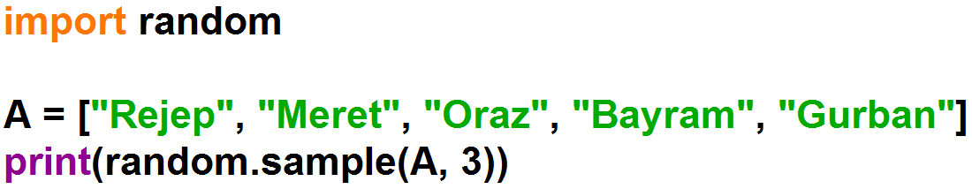
sample() function
Randomly select a specified number of unique elements from a sequence.

Slide 18
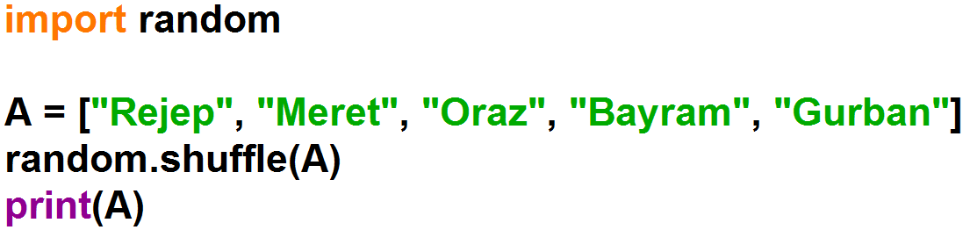
shuffle() function
Randomly reorder (or permute) the elements of a sequence in place.

Slide 19
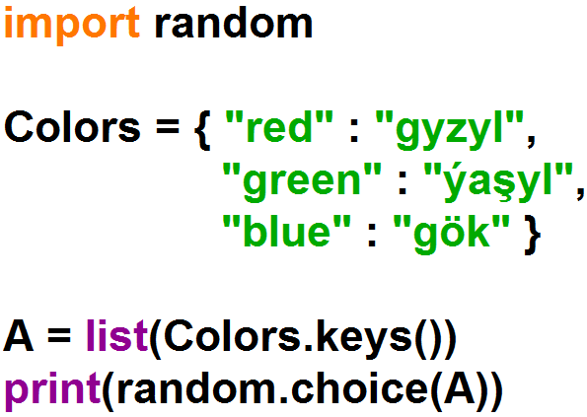

choice() function

Slide 20
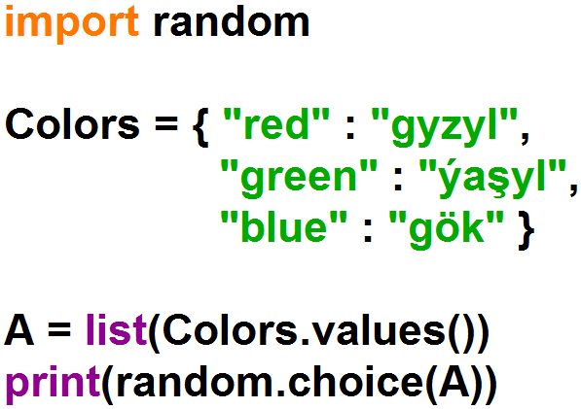

choice() function

Slide 21
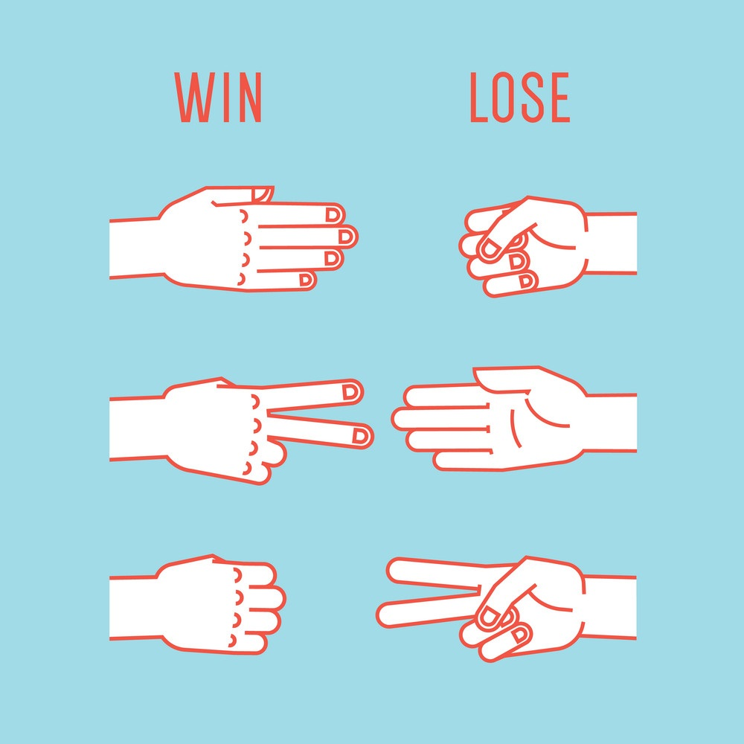

Example: Rock, Paper, Scissors Game

Slide 22
Example: Rock, Paper, Scissors Game
Player | Computer
rock | rock
 | paper
 | scissors
paper | rock
 | paper
 | scissors
scissors | rock
 | paper
 | scissors

Slide 23
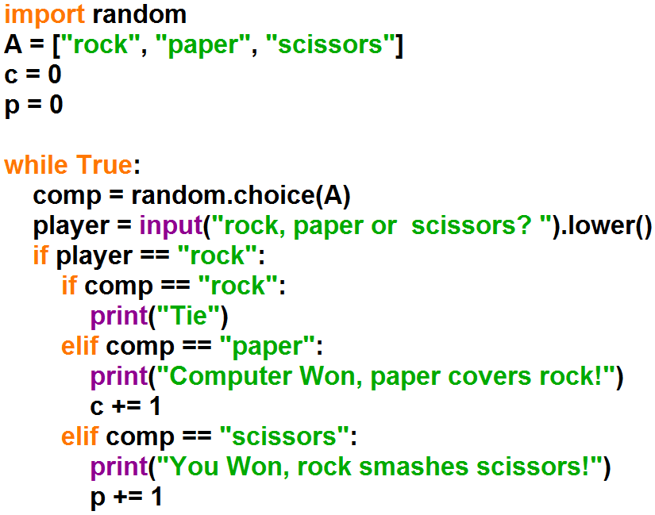
Example: Rock, Paper, Scissors Game

Slide 24
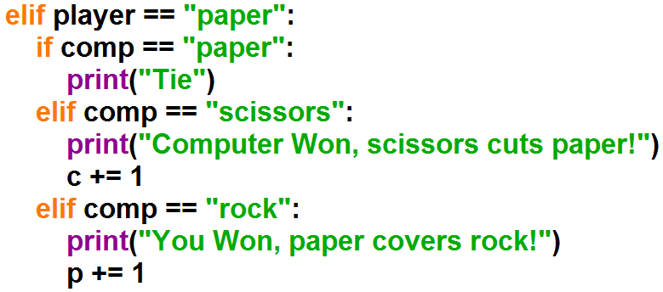
Example: Rock, Paper, Scissors Game

Slide 25
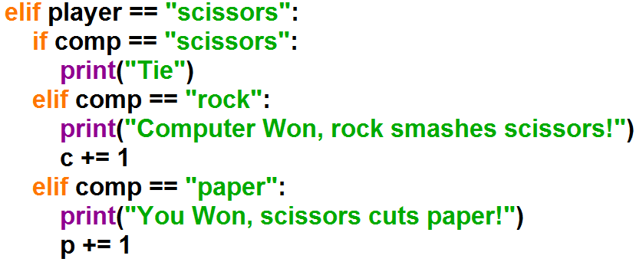
Example: Rock, Paper, Scissors Game

Slide 26
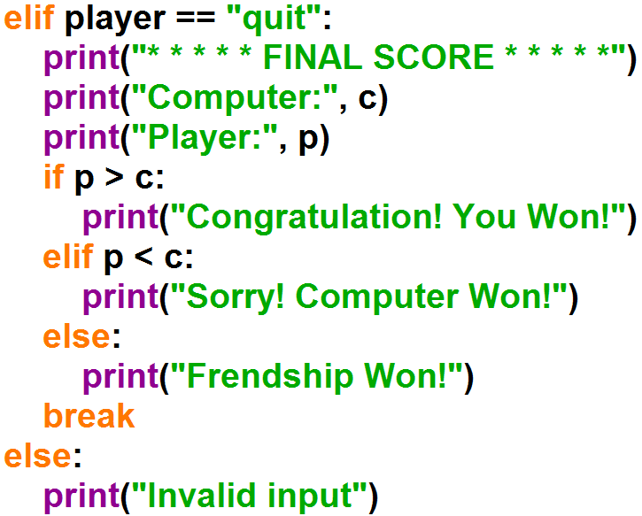
Example: Rock, Paper, Scissors Game

Slide 27
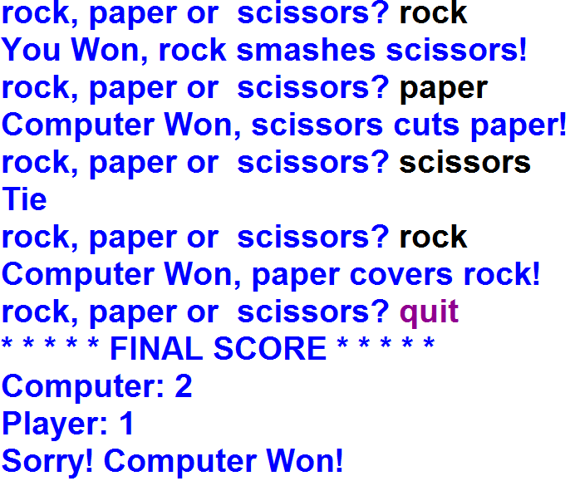
Example: Rock, Paper, Scissors Game

